Slide 1
DBMS MINI PROJECT RAILWAY DATABASE MANAGEMENT SYSTEM 5TH SEMESTER, ISE SAI VIDYA INSTITUTE OF TECHNOLOGY
DONE BY:
JYOTSNA B (1VA18IS010)
POOJA GUTTAL (1VA18IS023)
SRIMA SHETTY (1VA18IS045)

Slide 2
ABSTRACT
RAILWAY DATABASE MANAGEMENT SYSTEM, the purpose of this management system is to assist any railway business with ease of access information about their bookings when required without going through the hassle of manual bookings. Railway Database Management System gives businesses an environment where they can easily check and update the latest information about their bookings. They can manage and automatically provide the user with ticket info via email. The Railway Database Management System is aimed to provide the relevant information about the tickets and bookings of a railway database and eliminate manual counters and bookings.

Slide 3
PROBLEM
Existing systems for Railway Database Management are very inefficient and mostly involve a lot of manual work to be done by the manager of the system. With this project, we want to automate as many tasks as possible using the available technology and the internet

Slide 4
OBJECTIVE
The main objective of this project is to determine how an interactive Railway Database management system helps in the smooth functioning of a Railway compared to traditional Railway database management, by digitizing all the records and transacting everything on a Computer rather than on paper. This project is a two-tier architecture application

Slide 5
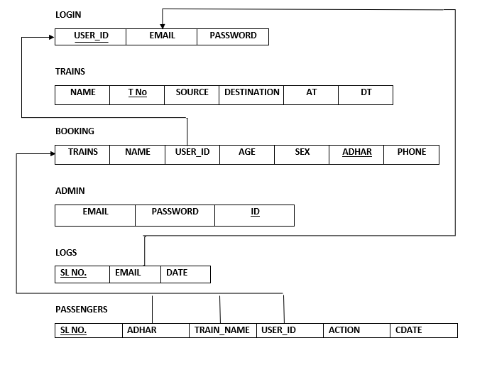
SCHEMA DIAGRAM

Slide 6
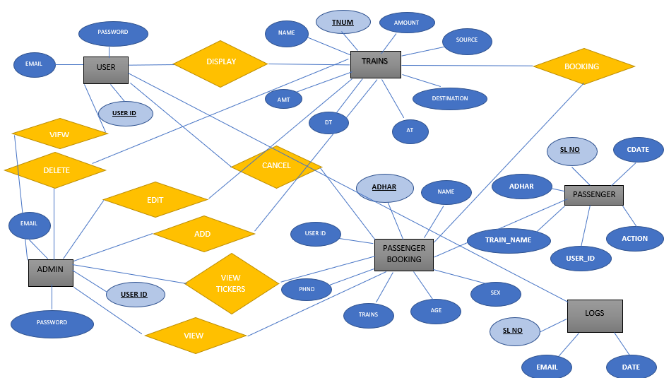
ER DIAGRAM

Slide 7
WEB PAGES
adminbooking.php
adminadd.php
admindelete.php
adminedit.php
adminlogin.php
adminlogout.php
adminnavigation.php
admintrains,php
booking.php
cancelticket.php
adminregistrations.php
display.php
login.php
logout.php
navigate.php
register.php
ticket1.php

Slide 8
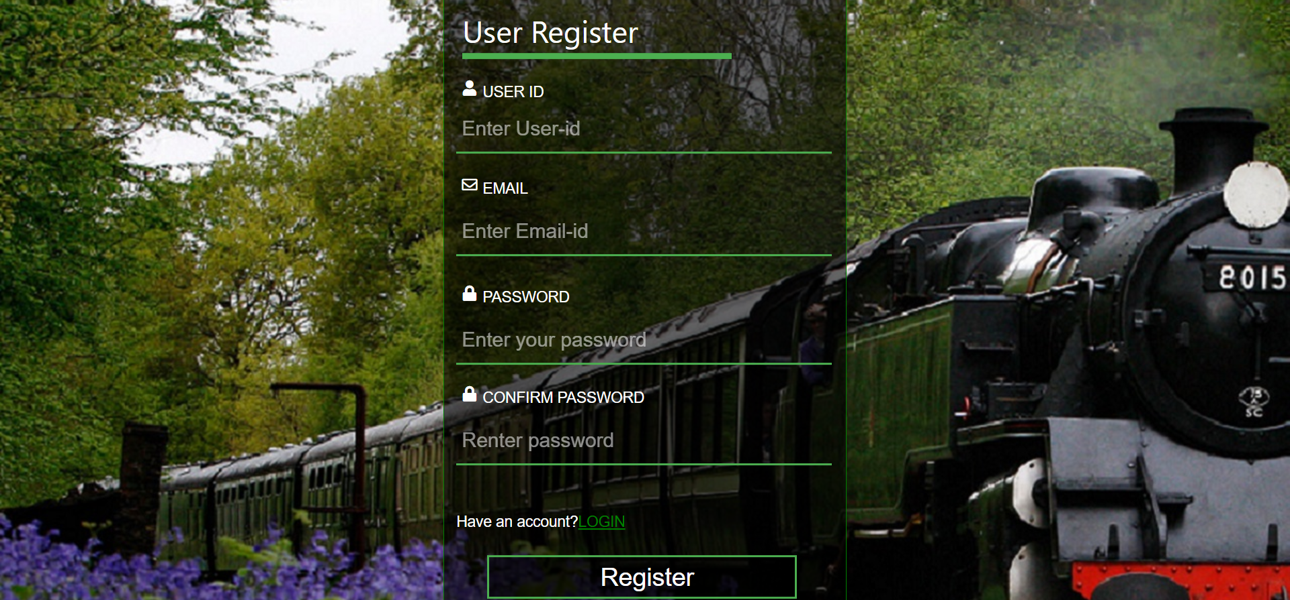
USER REGISTER

Slide 9
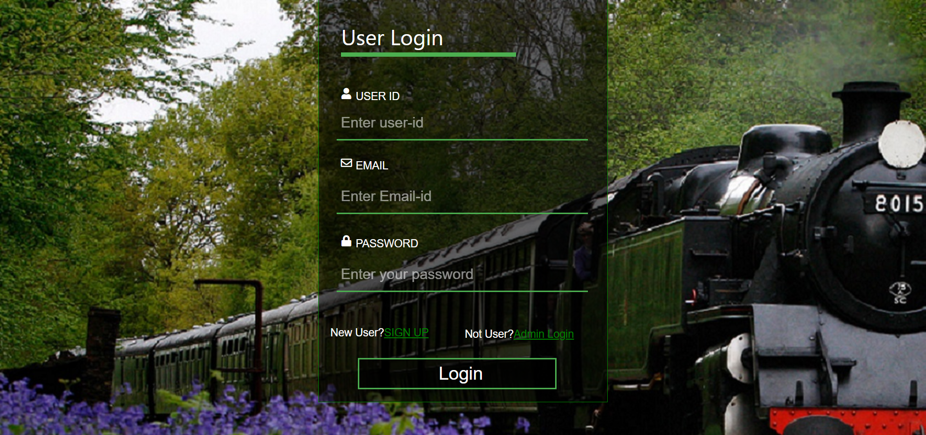
USER LOGIN

Slide 10
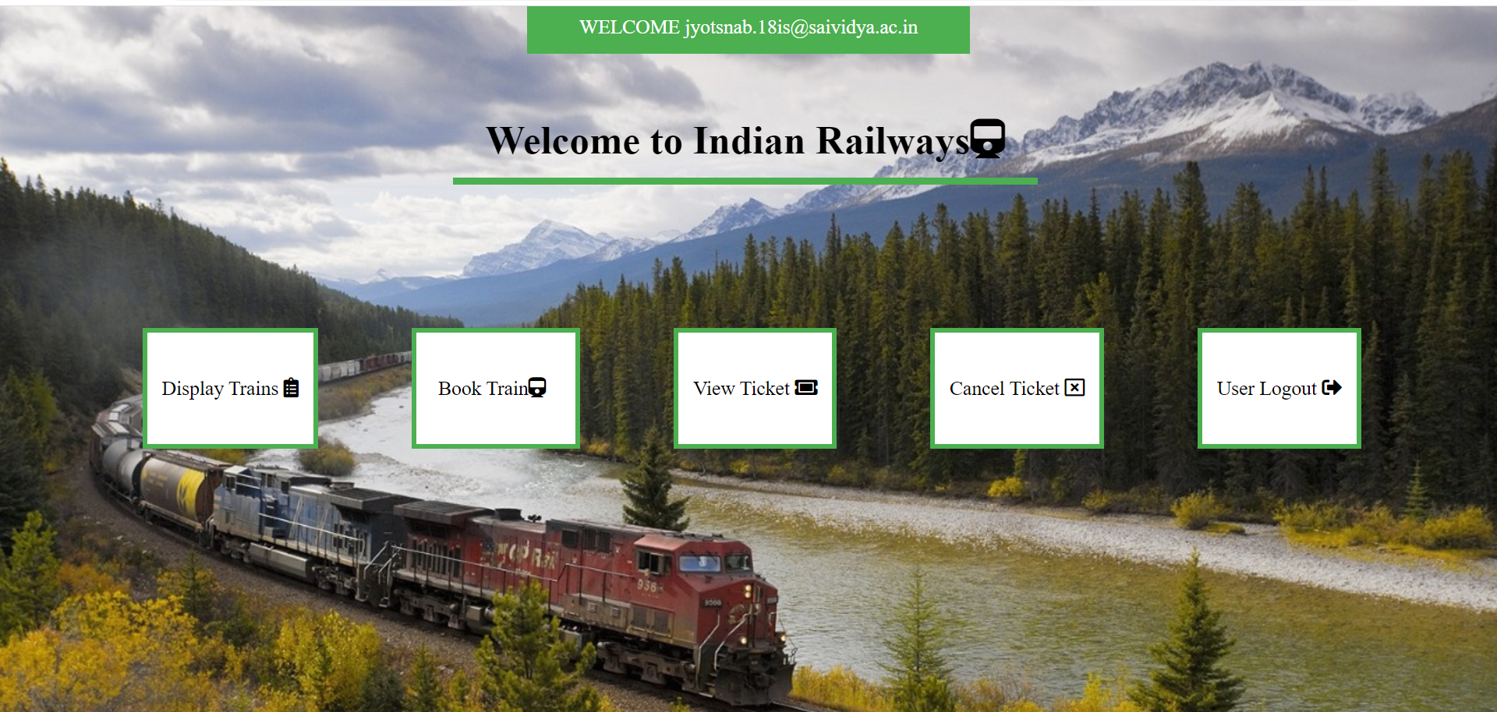
USER NAVIGATION

Slide 11
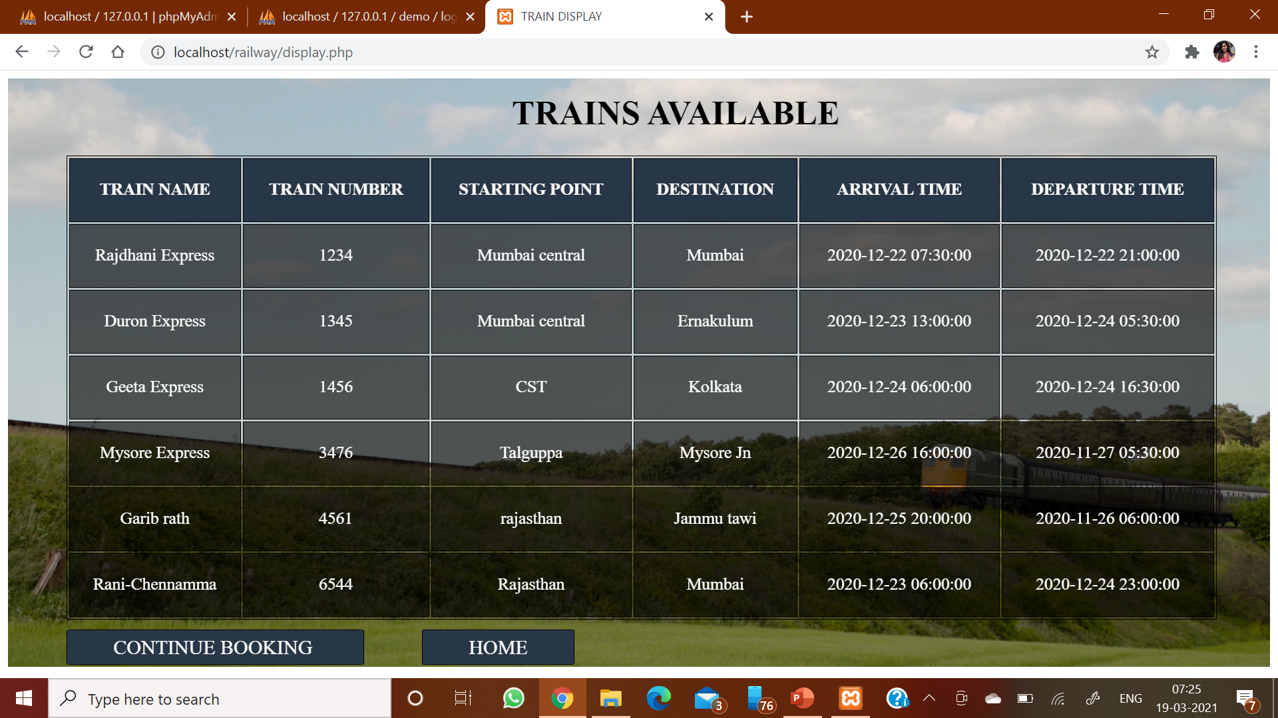
TRAINS DISPLAY

Slide 12
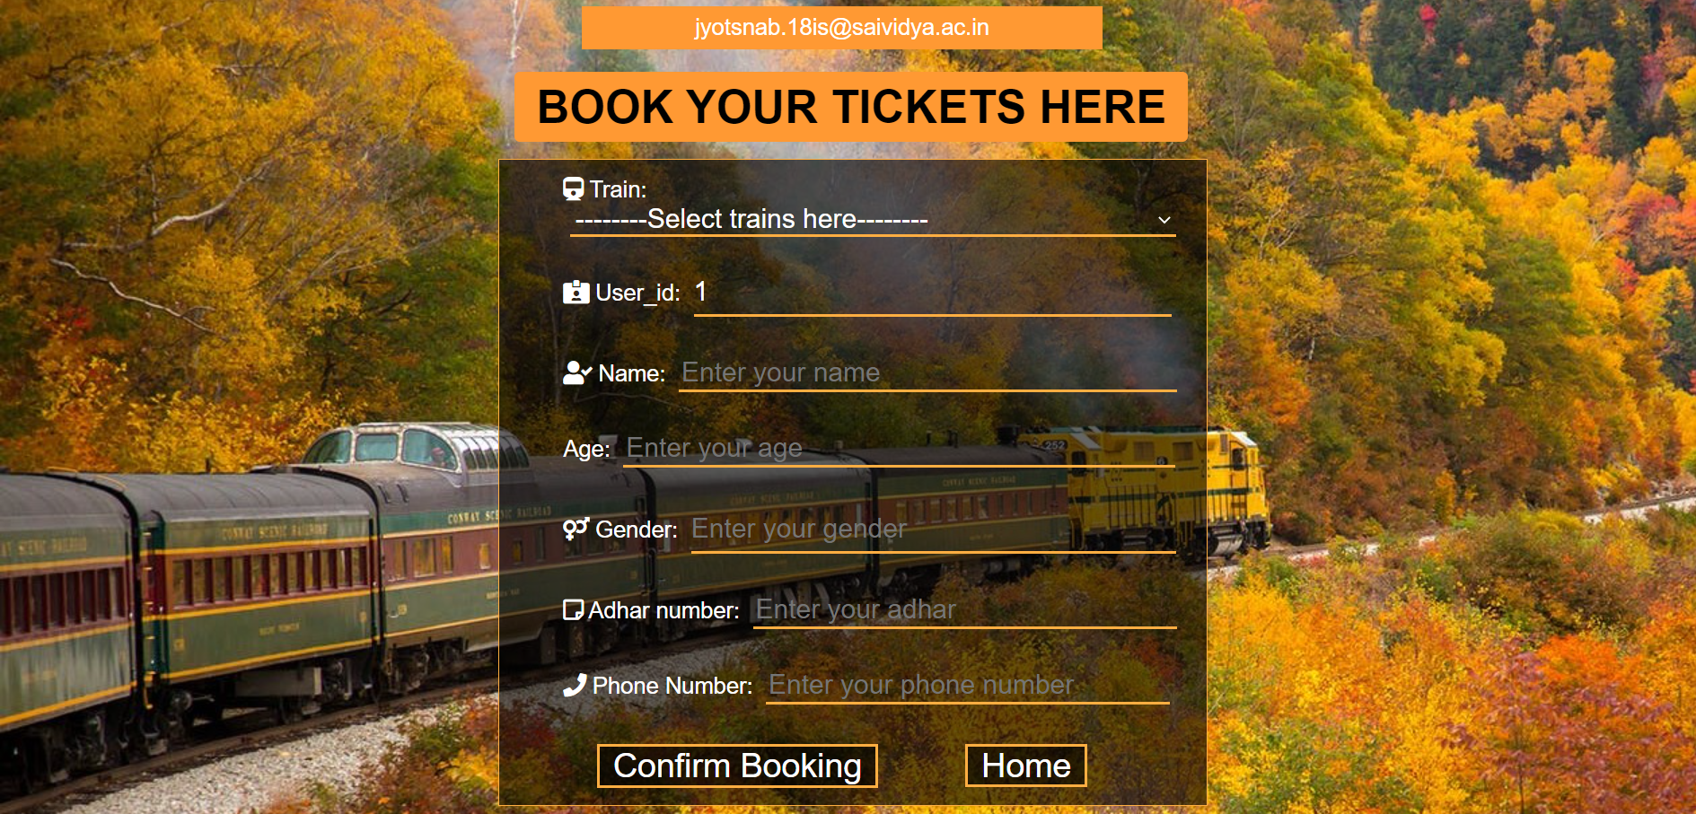
TRAIN BOOKING

Slide 13
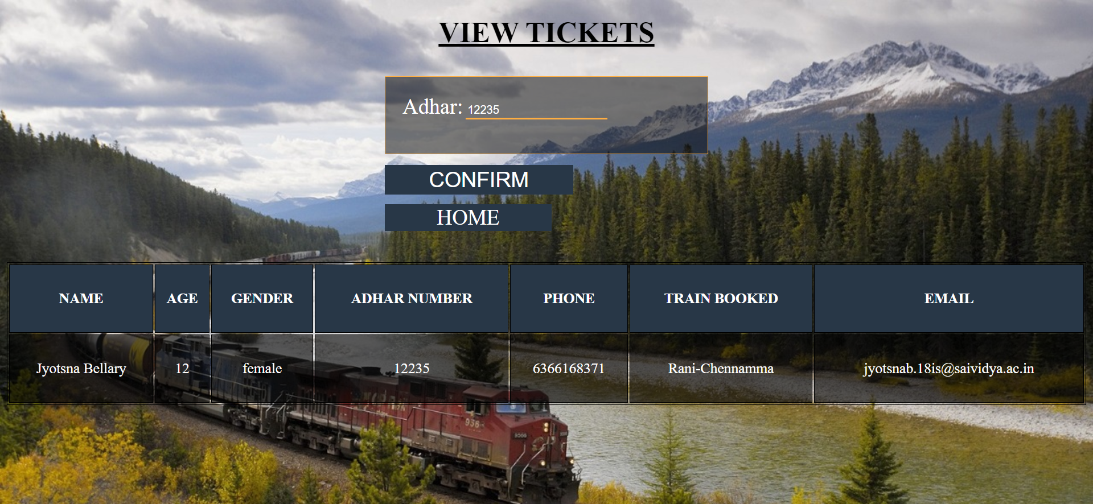
TICKET VIEW

Slide 14
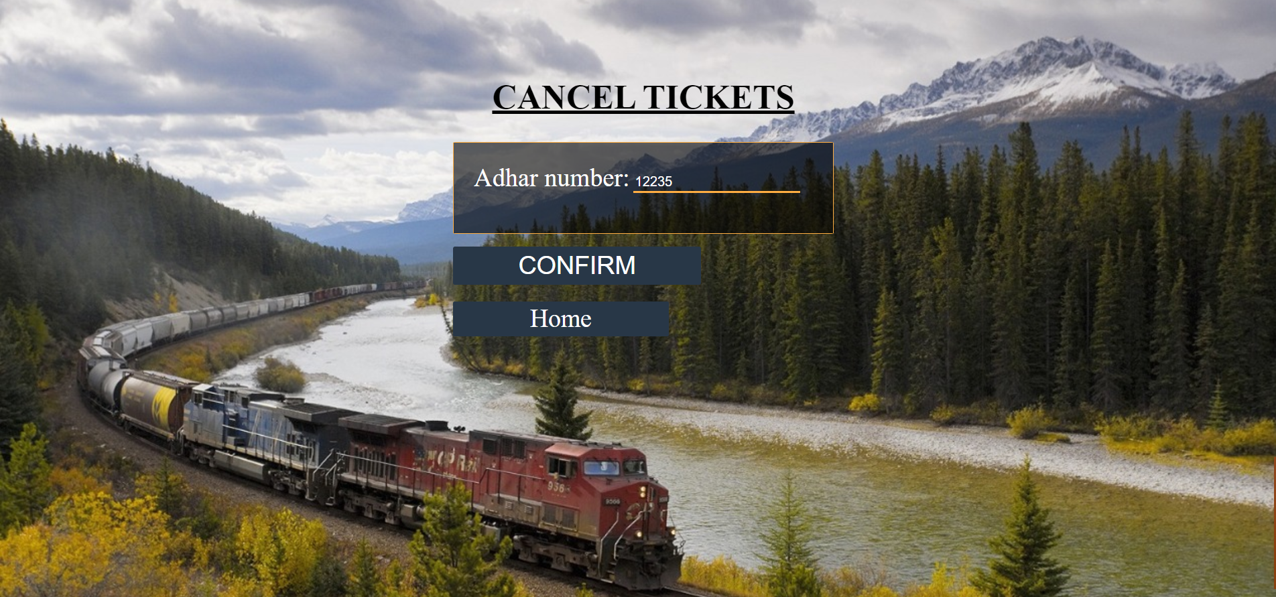
CANCEL TICKET

Slide 15
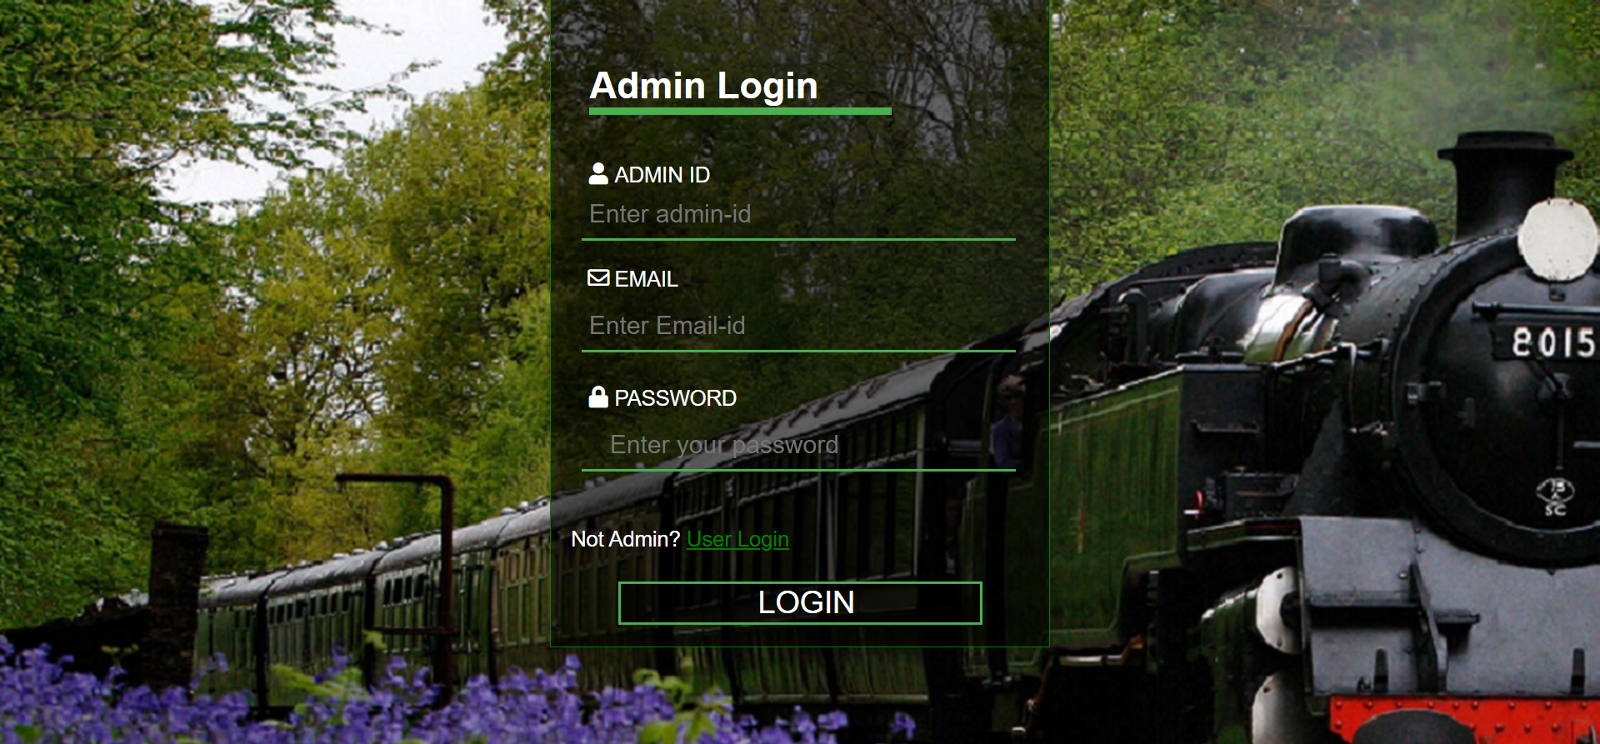
ADMIN LOGIN

Slide 16
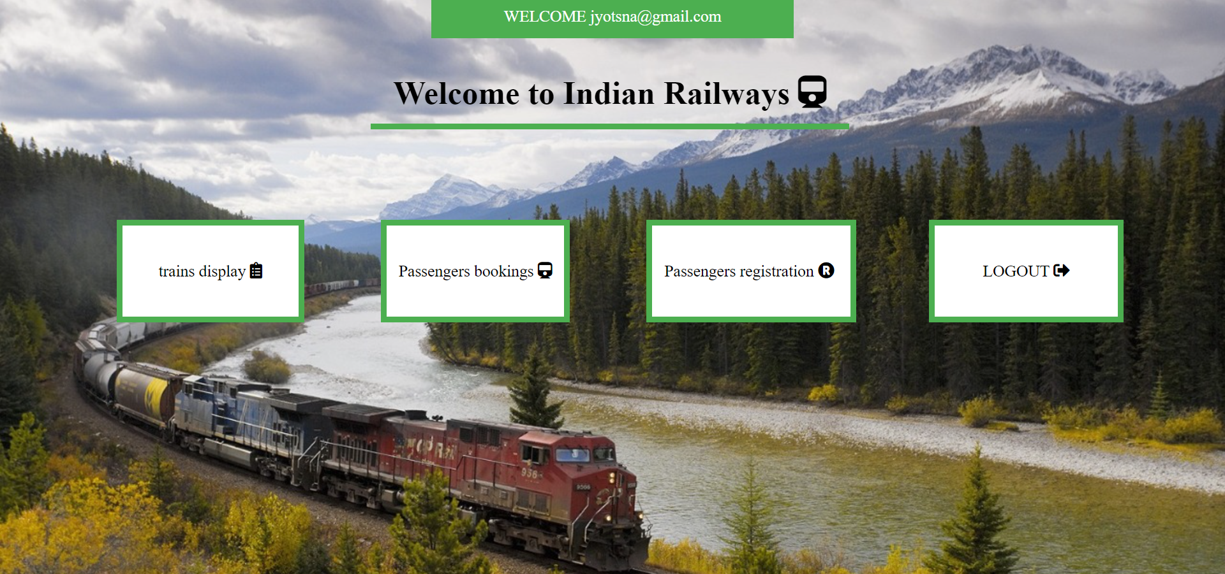
ADMIN NAV

Slide 17
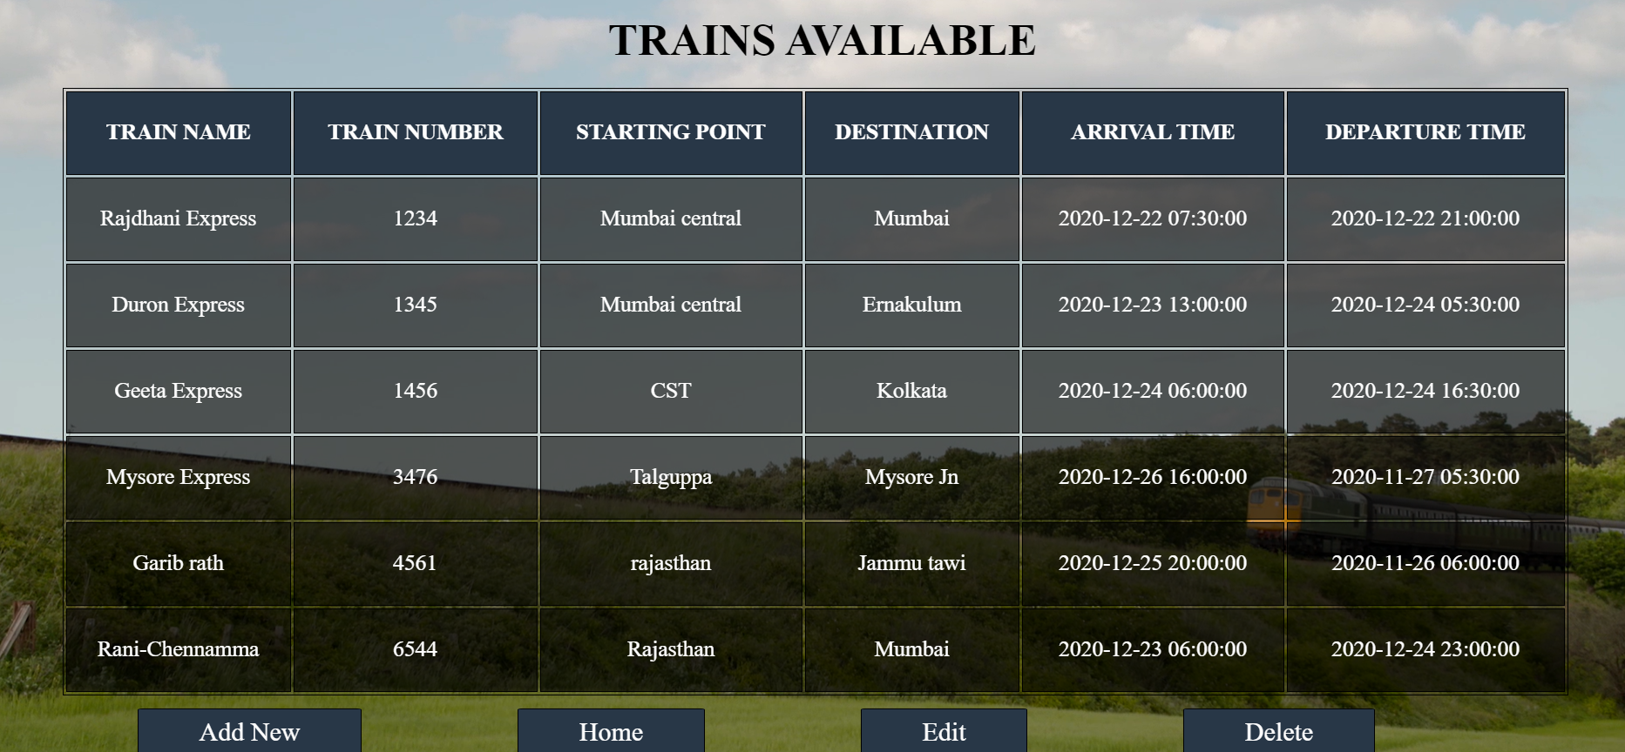
ADMINTRAINS

Slide 18
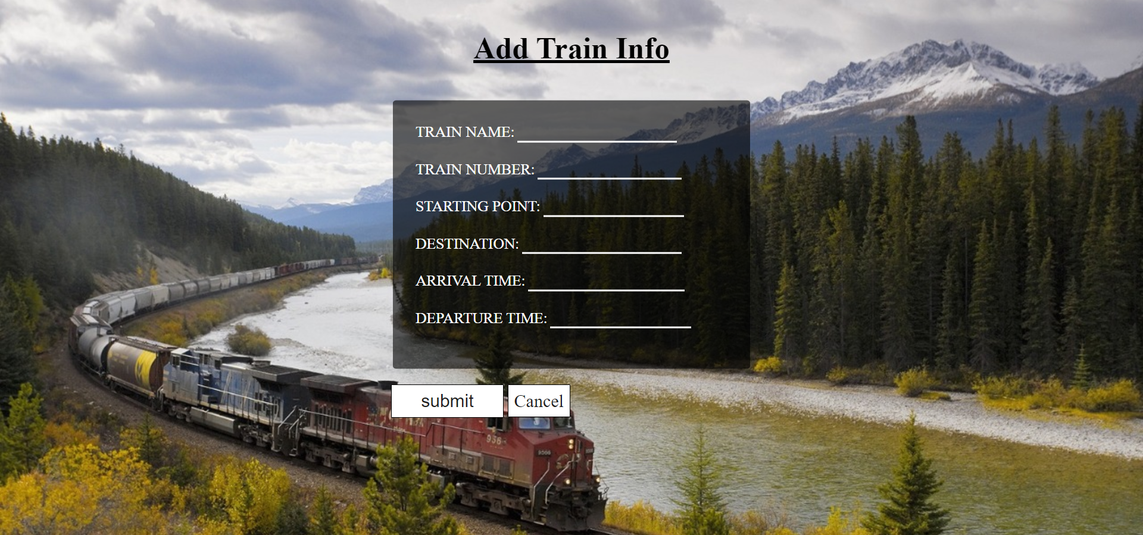
ADMINADD

Slide 19
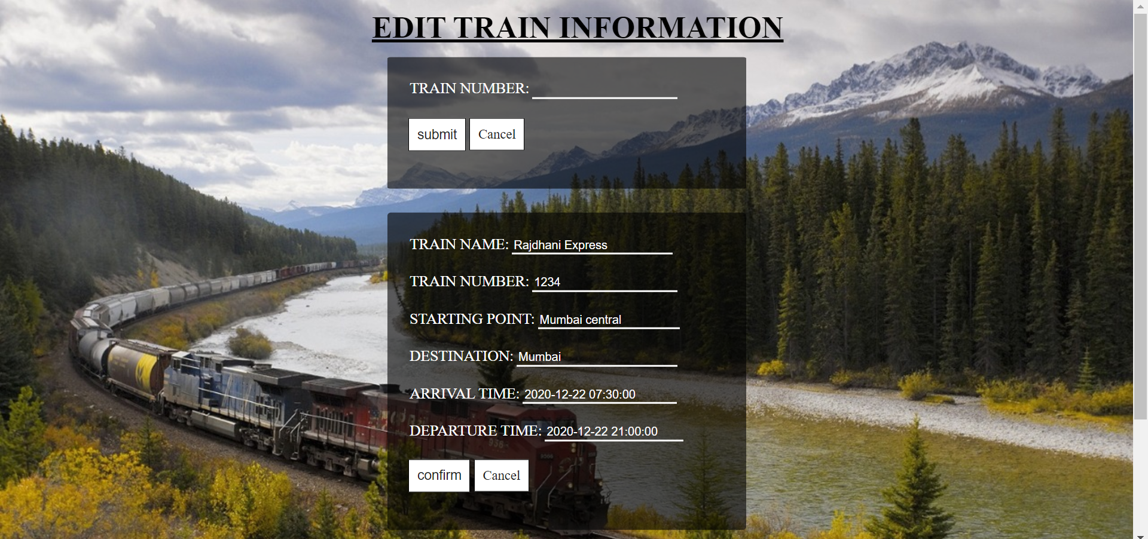
ADMINEDIT

Slide 20
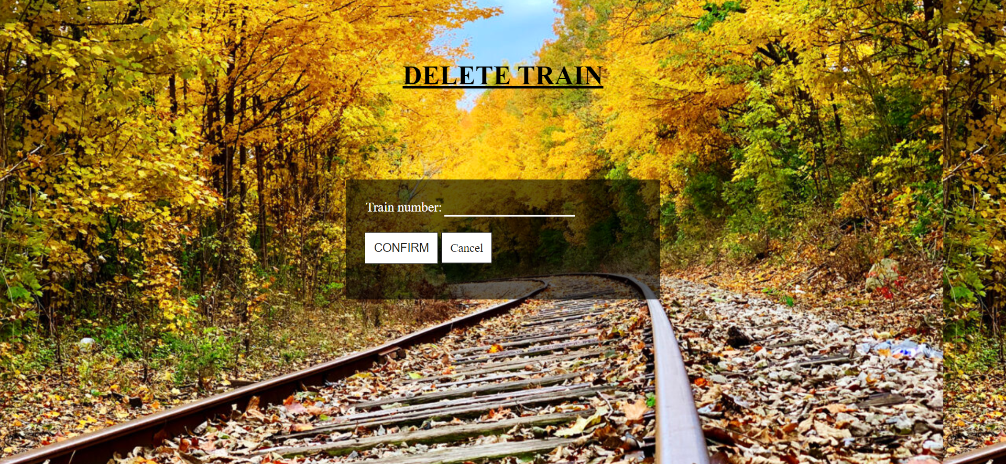
DELETE TRAIN

Slide 21
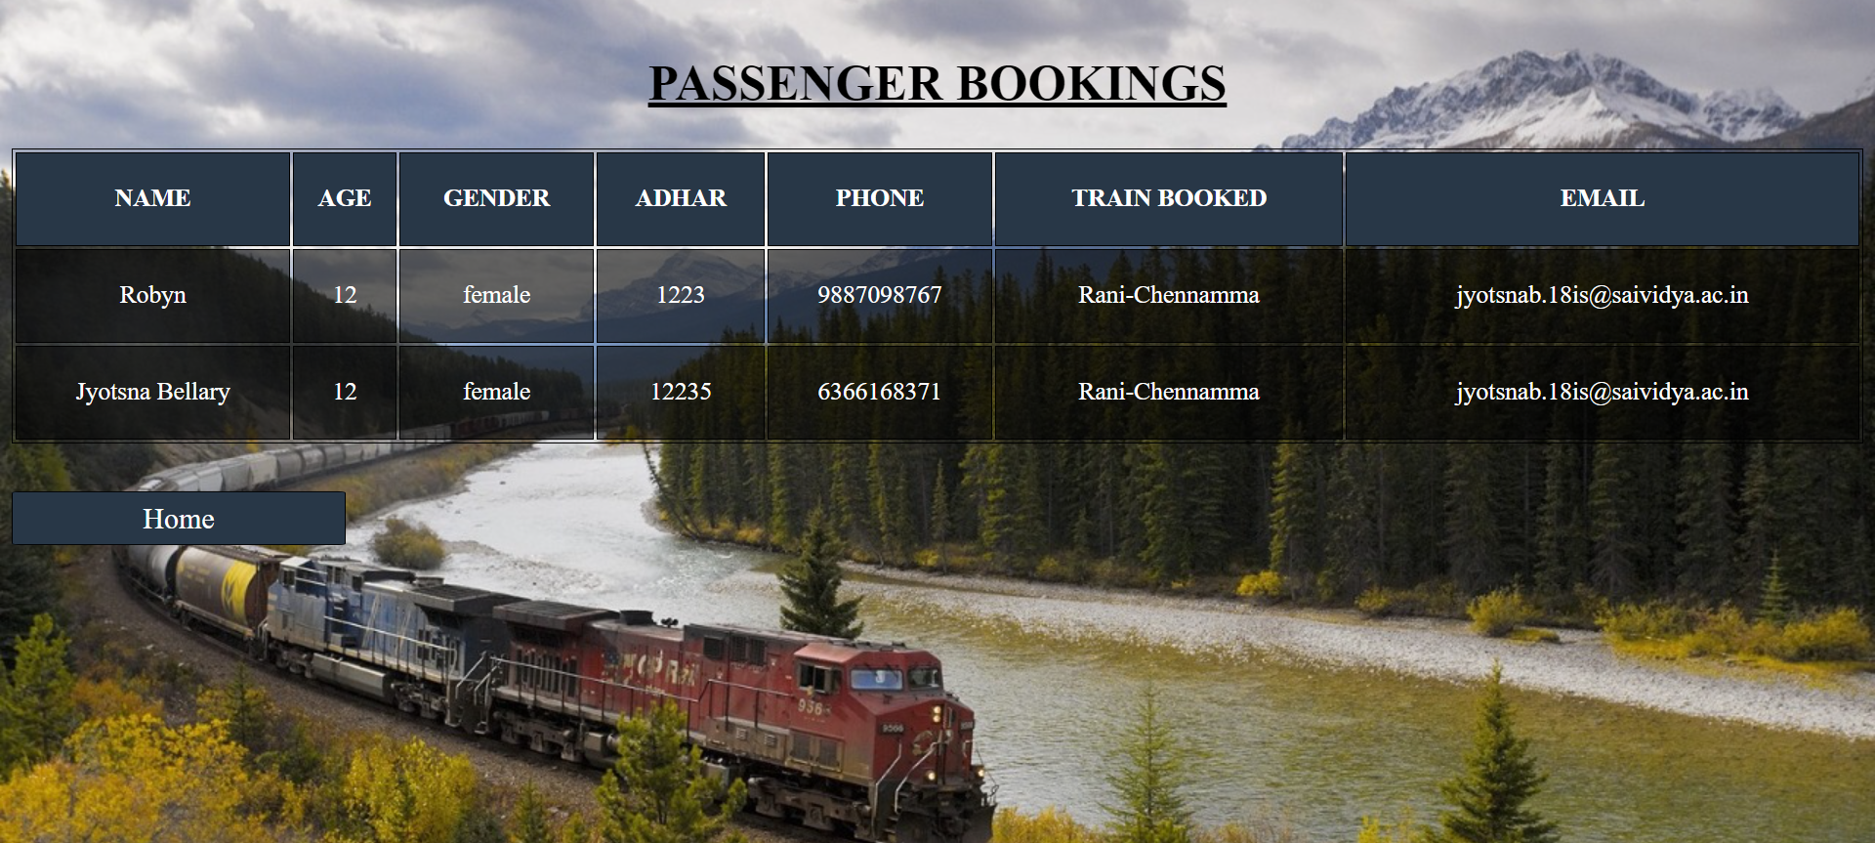
ADMIN BOOKING

Slide 22
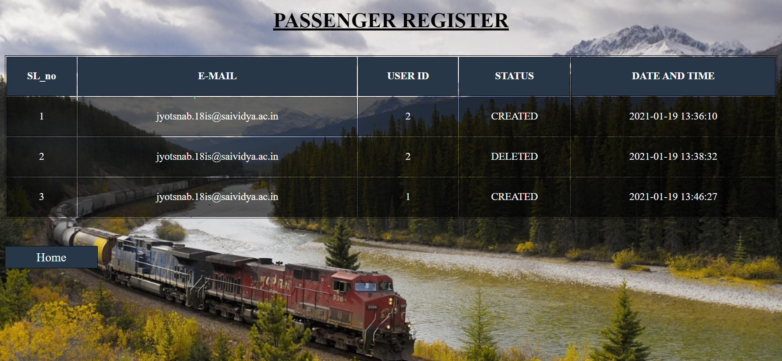
PASSENGER REGISTER

Slide 23
DATABASE TABLES
LOGIN
TRAIN_BOOKED
ADMLOG
TRAIN_DISPLAY
LOGS
PASSENGERS

Slide 24
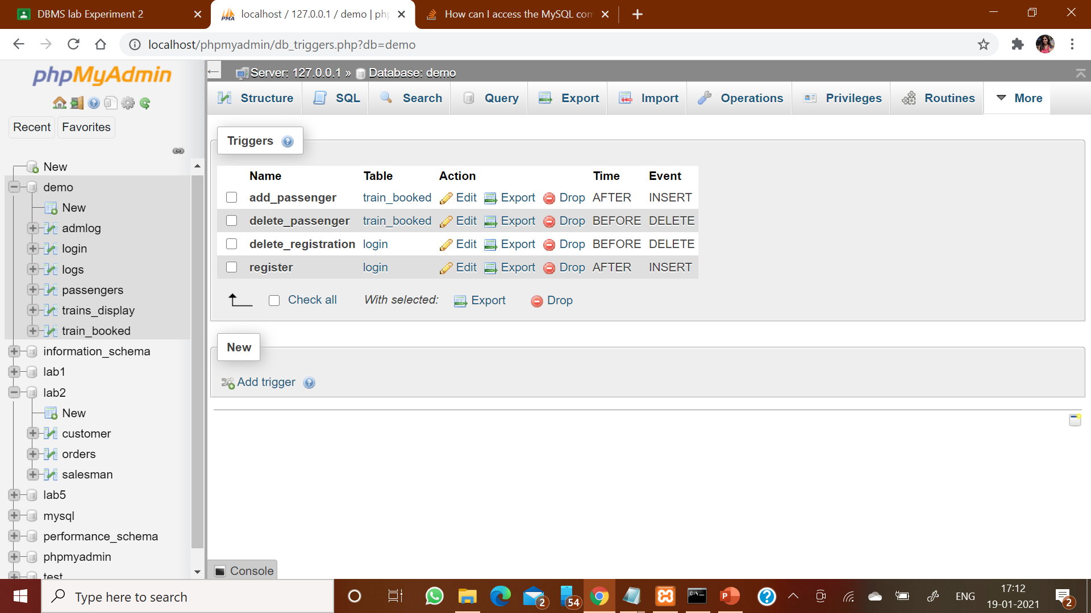
TRIGGERS

Slide 25
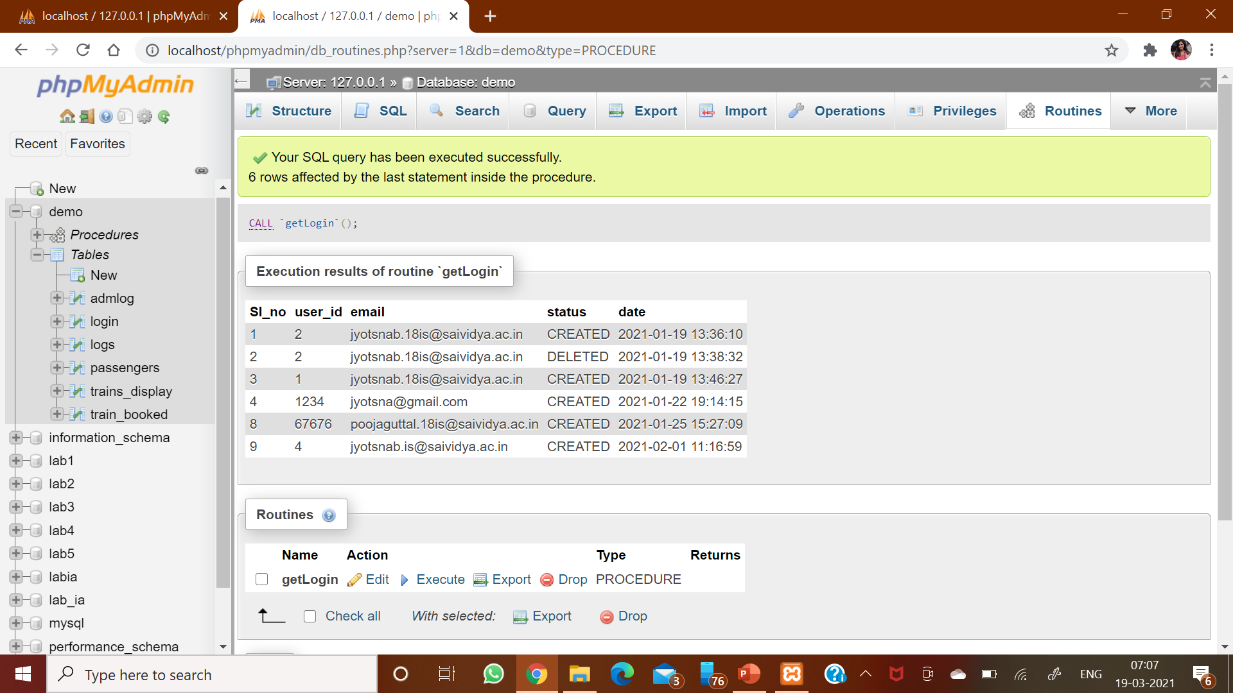
PROCEDURES

Slide 26
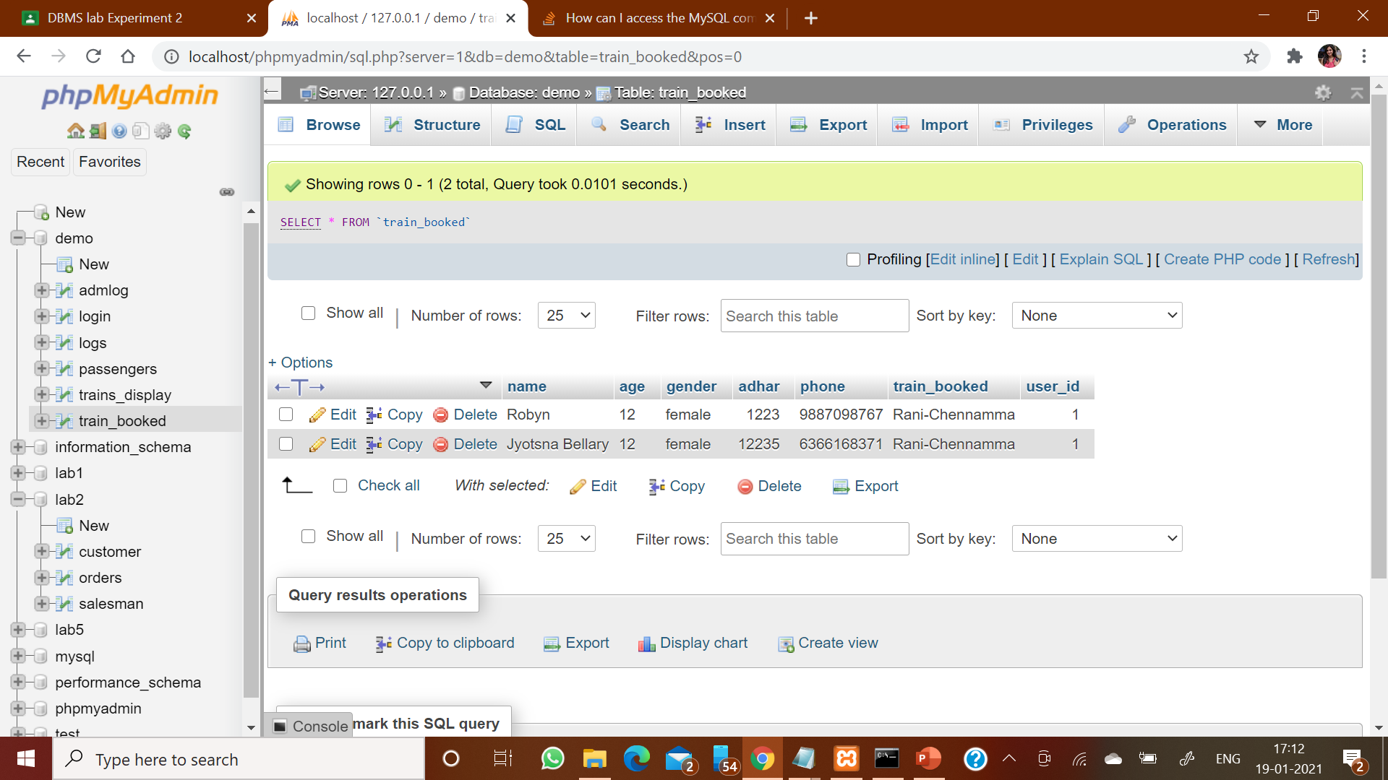
train_booked

Slide 27
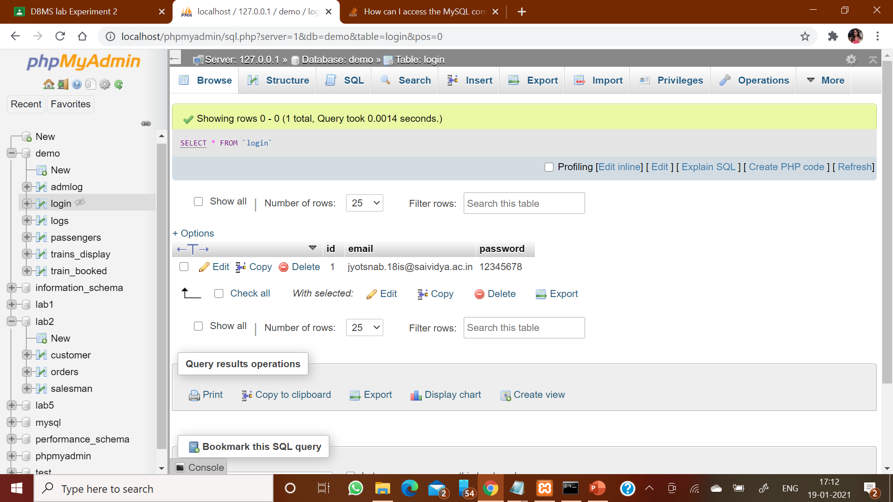
login

Slide 28
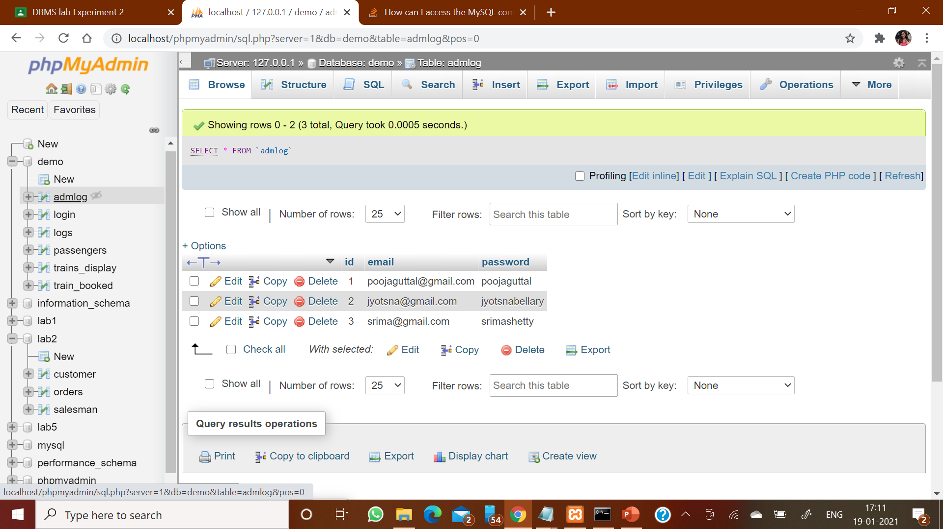
admlog

Slide 29
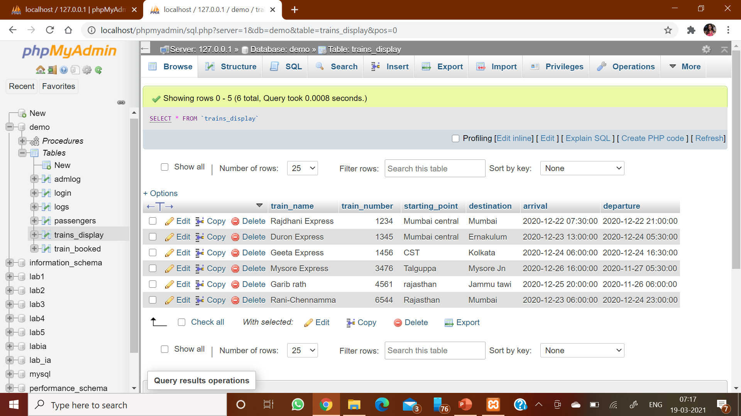
train_display

Slide 30
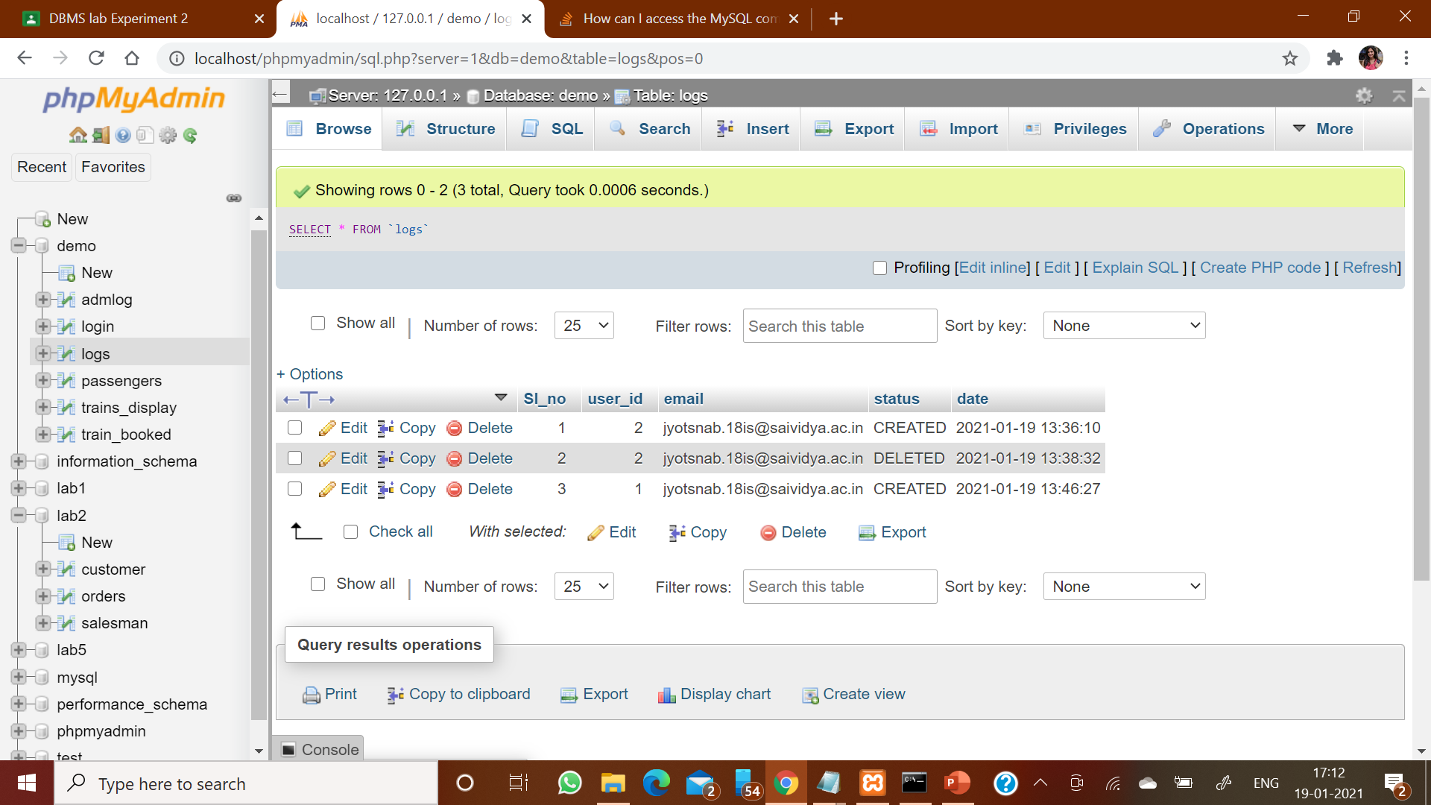
logs

Slide 31
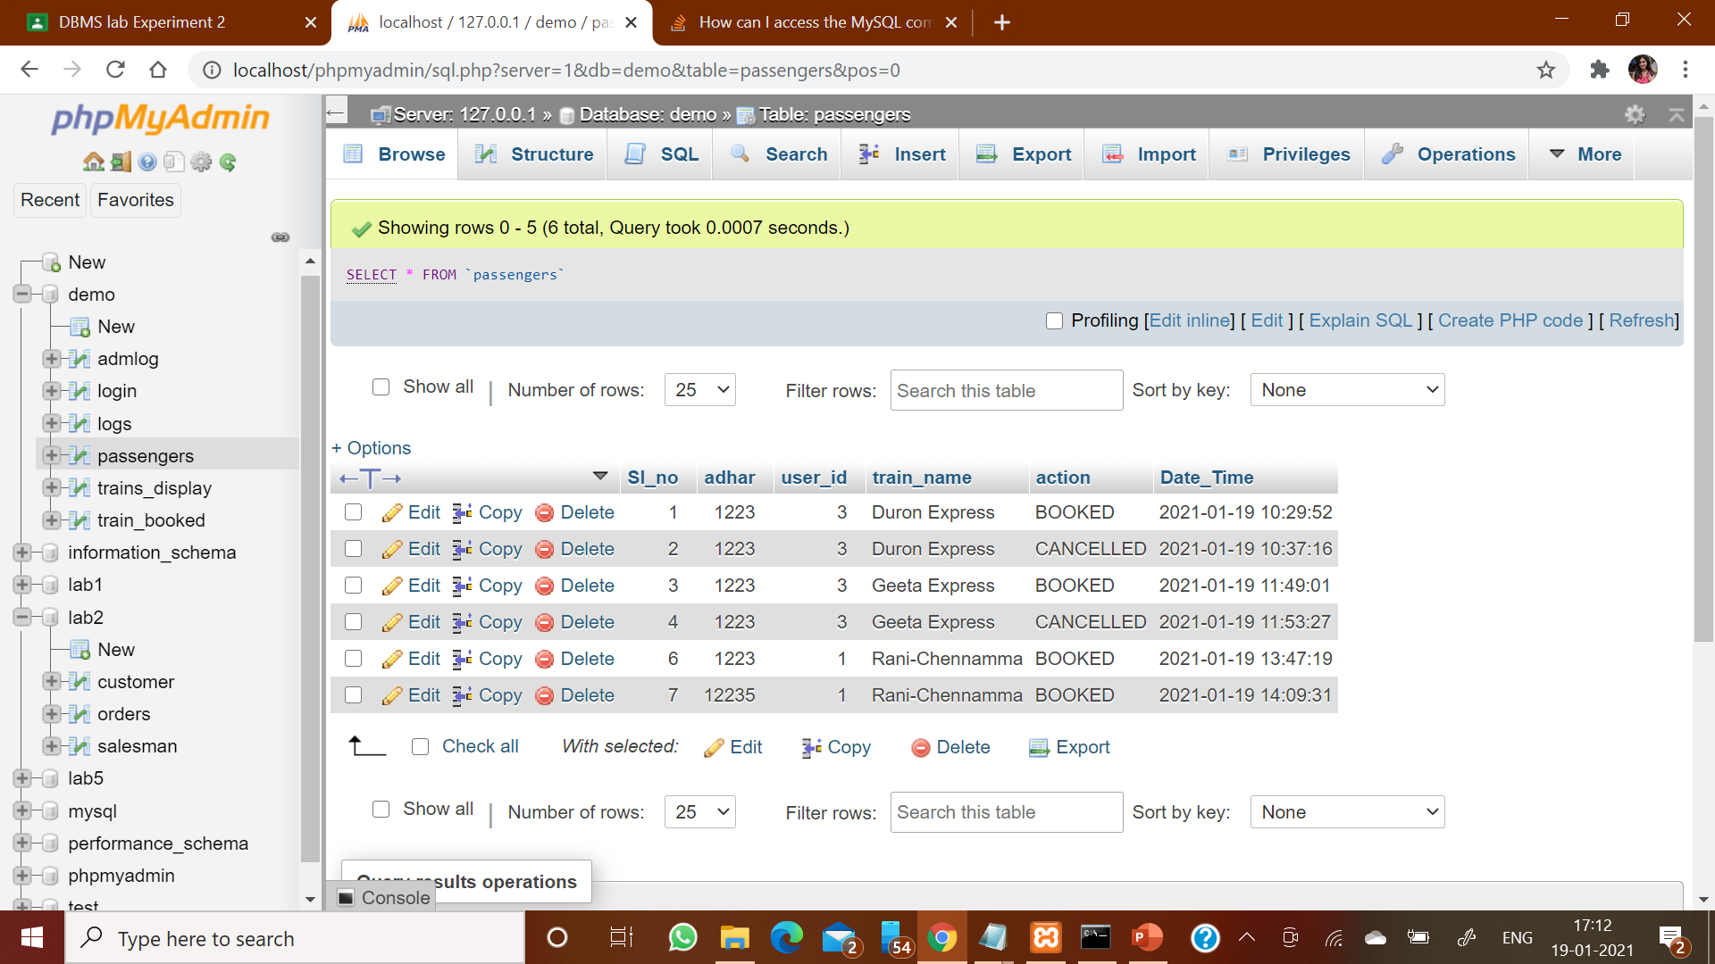
passengers

Slide 32
CONCLUSION
The railway database management system provides better functionality for a booking system to be more efficient and reduce manual paperwork in order to automate all possible tasks. For implementing this system, HTML, CSS, PhP and Xampp are used. The system comprises of features like, management of users, management of booking, automated ticket generation and booking or cancelling of tickets.

Slide 33
SCOPE OF EHANCEMENT
Add a payment portal
Below list shows the future points to be considered:
Utilize multithreading to manage resources better.
Use hashing algorithms for storing passwords and avoid plaintext passwords.
Implement the update feature with hardware integration in the booking system.
Port the program to other popular operating systems.
Implement feature to book multiple seats seats at once.

Slide 34
THANK YOU

